Slide 1

#AzureSQL
Azure SQL:
What to use when
Anna Hoffman, Data & Applied Scientist / PM
Microsoft Azure Data
October 2020
Notes:
Anna leads, introduces herself and asks Bob to introduce himself
LAYOUT : 2 Person Demo

Slide 2
Introduction to Azure SQL
SQL
Overview
SQL Server on Azure VMs
Azure SQL Managed Instance
Azure SQL Database
Comparison and summary
Notes:
Anna
LAYOUT : 2 Person Demo. Next slide goes to 2 Person Desktop TR

Slide 3

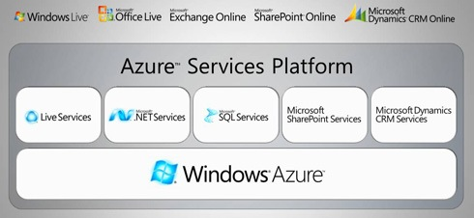
History of Azure SQL
Overview
SQL Server on Azure VMs
Azure SQL MI
Azure SQL Database
Comparison and summary
Notes:
Anna
LAYOUT : 2 Person Desktop TR

Slide 4
Azure SQL has come a long way
2006
CloudDB
RedDog
2008
Windows Azure and SQL Data Services announced
2010
Windows Azure and SQL Azure launch
2012
SQL Azure →
Azure SQL Database
2013
Azure
Virtual Machines
2014
Windows Azure → Microsoft Azure
2015
Azure SQL Database V12
2016
Azure SQL Database Elastic Pools
2018
Azure SQL Database Managed Instance
2019
Azure SQL Database Hyperscale
Azure SQL Database Serverless
Azure SQL Instance Pools
Overview
SQL Server on Azure VMs
Azure SQL MI
Azure SQL Database
Comparison and summary
Notes:
Bob
LAYOUT : 2 Person Desktop TR
2006
CloudDB Project
RedDog Project
2008
Windows Azure and SQL Data Services announced at PDC
2010
Windows Azure and SQL Azure officially launch.
2012
SQL Azure branded Azure SQL Database
2013
Azure Virtual Machines released
2014
Windows Azure branded Microsoft Azure
2015
Azure SQL Database V12 released
2016
Azure SQL Database Elastic Pools released
2018
Azure SQL Database Managed Instance released
2019
Azure SQL Database Hyperscale Released
Azure SQL Database Serverless Released

Slide 5



Azure SQL
A unified SQL portfolio built on the industry-leading SQL Server engine
SQL Server on Azure Virtual Machines
Azure SQL Managed Instance
Azure SQL Database
Best for re-hosting and apps requiring OS-level access and control
Automated manageability features and OS-level access
Best for modernizing existing apps
Offers high compatibility with SQL Server and native VNET support
Best for building new apps in the cloud
Pre-provisioned or serverless compute and Hyperscale storage to meet demanding workload requirements
Infrastructure as a Service
Platform as a Service
Overview
SQL Server on Azure VMs
Azure SQL MI
Azure SQL Database
Comparison and summary
Notes:
Anna
LAYOUT : 2 Person Desktop TR

Slide 6

SQL Server on Azure VMs provides the promise of the cloud while maintaining OS control
Key features
SQL Server and OS server access
Expansive SQL and OS versions
Windows, Linux, Containers
File stream, DTC, and Simple Recovery model
SSAS, SSRS, and SSIS
Azure differentiators
Free Extended Security Updates for SQL Server 2008/R2
Automated Backups and Security Updates
Point in Time Restore with Azure Backup
Accelerated storage performance with Azure Blob Caching
435 percent overall return on an Azure IaaS investment over five years¹
Customer challenge
I want to migrate to the cloud as fast as possible but maintain operating system control and complete SQL Server functionality
Solution
Get the combined performance, security, and analytics of SQL Server, backed by the flexibility, security, and hybrid connectivity of Azure
Healthcare software manufacturer saves costs when reusing licenses while moving 600 on-premises VMs to Azure
1. Forrester Consulting. The Total Economic Impact™ of Microsoft Azure SQL Database Managed Instance.
Overview
SQL Server on Azure VMs
Azure SQL MI
Azure SQL Database
Comparison and summary
Notes:
LAYOUT : 2 Person Desktop. Next slide goes to 2 Person Desktop TR
Anna lead in, Bob talk about features/diff, Anna to talk about customer
NOTE: Can we remove the SQL icon and shorten the title so that we can stay in TR layout?
Anna: That’s the SQL VM icon, I think it should stay so people associate the two. I don’t know what TR is but you can put us in the bottom right, the Allscripts part animates last
Best for migrations and applications requiring OS-level access
Challenges
The contract on my hardware is expiring
I have instances of SQL Server 2008 and 2008 R2
I want to migrate to the cloud as fast as possible
I use third party software that needs OS-level access
I have dependencies on SSRS
I want to extend our on-premises apps to Azure
I need an unlimited number of DBs
I want the full feature set of SQL Server 20XX
Solution
SQL Server and OS server access
Expansive SQL and OS version support
File stream, DTC, and Simple Recovery model available
Automated patching and backup
Free Extended Security Updates for SQL Server 2008/R2*
435 percent overall return on an Azure IaaS investment over five years (Forrester Consulting)
Up to 3.4x faster and 87% cheaper than AWS EC2**
Azure Key Vault integration
Support for Linux and Windows
Note: maybe only 1 here – the best one, rest in notes
Does your application require custom VM or SQL config? DB engine version choice, feature compatibility with SQL box, app portability, access to VM/OS
* ESU worth 75% of license every year for the next three years after EOS; ** Applicable to Azure Marketplace images, customers using customer SQL Server 2008/R2 custom images can download the ESU for free and manually apply.
VMs: Allscripts https://customers.microsoft.com/en-us/story/allscripts-partner-professional-services-azure
Move 600 VMs to Azure within a few weeks. Some time later moving some to MI
Rehost SQL Server 2008 and 2008 R2 in Azure Virtual Machines to get three years of Extended Security Updates at no additional charge and upgrade to a newer version when ready
435 percent overall return on an Azure IaaS investment over five years (for a composite organization based on the interviewed customers) (Forrester Consulting)
https://azure.microsoft.com/en-us/overview/azure-vs-aws/cost-savings/#sql-server-iaas

Slide 7
SQL Server on Azure Virtual Machines
Marketplace pre-installed SQL Server on Windows or Linux
Install your own SQL Server
Lift and Shift with Azure Migrate (Azure Site Recovery)
Deployment Choices
Unlock Licensing and Edition Flexibility
Automated Backups and Security Updates
Manage VMs through Azure SQL in portal
SQL IaaS Extension
Memory or Storage optimized sizes for best performance
Data and log on Premium Storage Managed Disks
Azure Blob Read Caching for data disks
Tempdb on local SSD
Ultra disks for extremely low latency needs
Sizes and Storage Performance
Networking and Security
Virtual Networks to integrate with on-premises
Advanced Data Security services (Preview)
Azure VM built-in HA
Azure Storage built-in DR
Azure Backup and Automated backups to Azure Blob Storage
File-Snapshot Backups
Failover Cluster Instance with Azure Premium File Share
Always On Availability Groups with Cloud Witness
Hybrid Availability Group Secondary replicas
HADR on RedHat Linux with Pacemaker and fencing
HADR
Overview
SQL Server on Azure VMs
Azure SQL MI
Azure SQL Database
Comparison and summary
Notes:
LAYOUT : 2 Person Desktop TR. Next slide goes to Desktop Only
Bob

Slide 8
IaaS vs PaaS
Business continuity
Scale
High availability
Advanced security
Automated backups
Version-less
Long term backup retention
Built-in monitoring
Geo-replication
Built-in intelligence
Overview
SQL Server on Azure VMs
Azure SQL MI
Azure SQL Database
Comparison and summary
Notes:
Anna to lead and take left side, Bob to take right side
LAYOUT : Desktop Only. Next slide goes to 2 Person Desktop TR
Business continuity enables your business to continue operating in the face of disruption, particularly to its computing infrastructure.
High availability of Azure SQL Database guarantees your databases are up and running 99.99% of the time, no need to worry about maintenance/downtimes.
2 read replicas - GP
3 replicas, 1 read-scale replica, zone-redundant HA - BC
Primary read/write replica + up to 4 read replicas - HS
Automated backups are created and use Azure read-access geo-redundant storage (RA-GRS) to provide geo-redundancy.
Also Point in Time restore
Long term backup retention enables you to store specific full databases for up to 10 years.
Geo-replication by creating readable replicas of your database in the same or different data center (region). You can manually failover to readable replicas
Also Auto-failover groups allows an application to recover in case of a data center outage
Scale by easily adding more resources (CPU, memory, storage) without long provisioning.
Advanced security detects threats and vulnerabilities in your databases and enables you to secure your data.
Automatic tuning analyzes your workload and provides you the recommendations that can optimize performance of your applications by adding indexes, removing unused indexes, and automatically fixing the query plan issues.
Built-in monitoring capabilities enable you to get the insights into performance of your databases and workload, and troubleshoot the performance issues.
Built-in intelligence automatically identifies the potential issues in your workload and provides you the recommendations that can help you to fix the problems.
Versionless
Azure SQL Database and Managed Instance are versionless
Our “main branch” powers SQL Server, Azure SQL Database, and Managed Instance.
Microsoft consistently updates SQL Server instances
@@VERSION does not align with SQL Server versions
Fixes and feature updates not controlled by users
But…worry-free patching for both underlying OS and SQL Server
Updates are rolled out in “trains”.
New features can be whitelisted to specific customers (aka Private Preview)
Public Preview is typically available to all but limited support and discount pricing (if applicable)
All fixes in SQL Server eventually show up in Azure but timing may be different from CU
Not all fixes in Azure make it into a CU for SQL Server (but typically next major release)
Some fixes are specific to Azure
Follow these links to see new features, major fixes, and feature updates

Slide 9

Azure SQL managed instance eases cloud migration
Key features
Single instance or instance pool
SQL Server surface area (vast majority)
Native virtual network support
Fully managed service
On-premise identities enabled with Azure AD and AD Connect
Azure differentiators
Near zero downtime migration using log shipping
Fully managed business continuity with failover groups
Projected return on investment of 212 percent over three years¹
The best of SQL Server with the benefits of a managed service
Customer challenge
I want to migrate to the cloud, remove management overhead, but I need instance-scoped features (Service Broker, SQL Server Agent, CLR…)
Solution
Managed instance combines leading security features with SQL Server compatibility and business model designed for on-premises customers
Komatsu easily migrated 1.5 TBs of data thanks to near complete compatibility with SQL Server, plus 49% cost reduction and 25-30% performance gains.
1. Forrester Consulting. The Total Economic Impact™ of Microsoft Azure SQL Database Managed Instance.
Overview
SQL Server on Azure VMs
Azure SQL MI
Azure SQL Database
Comparison and summary
Notes:
Anna lead in, Bob talk about features/diff, Anna to talk about customer
LAYOUT : Desktop Only. Next slide goes to 2 Person Desktop TR
Best for most lift-and-shift migrations to the cloud
It is called an Instance because it is equivalent to a Database Engine Instance of SQL Server which we define actually in our docs at https://docs.microsoft.com/en-us/sql/database-engine/configure-windows/database-engine-instances-sql-server?view=sql-server-ver15. The term Database Engine Instance is important because other instance types for SQL Server are things like SSAS.
It's called Managed because it is a PaaS version of a Database Engine Instance where we manage several things including install of SQL Server, scaling, and high-availability.
Challenges
I want to migrate to Azure
I want to remove some of the management overhead and stress with regards to business continuity, high availability, and disaster recovery
I need instance-scoped features like SQL Server Agent, Database Mail, Service Broker, CLR, etc.
Solution
Single instance or Instance pool
SQL Server surface area (vast majority)
Native virtual network support
Fully managed Service
Enable your on-premise identities on cloud instances, through integration with Azure Active Directory and AD Connect
Near zero downtime migration using log-shipping
Fully managed business continuity with failover groups
Projected return on investment of 212 percent over three years (Forrester Consulting)
Combine the best of SQL Server with the benefits of a managed service
You get two levels of isolation:
Cluster level: Managed Instances for a tenant are fully isolated from other tenants. No connectivity or resource sharing is possible between different tenants.
Networking level: joining instances to a subnet in a VNET and restricting access to private IP addresses only provides full isolation from public Internet.
Managed Instance: Komatsu https://customers.microsoft.com/en-us/story/komatsu-australia-manufacturing-azure
Moved about 1.5 TBs of data very smoothly because of the near 100% compatibility with SQL Server
49% reduction in cost and 25% increase in performance gains

Slide 10

Azure SQL Database is built for modern cloud apps
Key features
Single database or elastic pool
Hyperscale storage (100TB+)
Serverless compute
Fully managed service
Private link support
High availability with AZ isolation
Azure differentiators
Industry highest availability SLA of 99.995%
Industry only business continuity SLA with 5 second RPO and 30 second RTO
Price-performance leader for mission-critical workloads while costing up to 86 percent less than AWS RDS (GigaOm)
Customer challenge
I want to build modern apps, potentially multi-tenanted, with the highest uptime and predictable performance
Solution
Azure SQL Database is a highly scalable cloud database service with built-in high availability and machine learning
AccuWeather uses Azure SQL Database to provide an automated, scalable weather prediction service
1. Forrester Consulting. The Total Economic Impact™ of Microsoft Azure SQL Database Managed Instance.
Overview
SQL Server on Azure VMs
Azure SQL MI
Azure SQL Database
Comparison and summary
Notes:
Anna lead in, Bob talk about features/diff, Anna to talk about customer
LAYOUT : Desktop Only
Best for modern cloud applications
Challenges
I want to build a modern multi-tenant SaaS app
I want to use a database with dedicated resources and predictable performance
I want to independently scale compute and storage in my database
I want to have unlimited databases storage when I need it
I want to build a mission critical application with highest uptime
I want to integrate Azure services into my applications
Solution
Single database or elastic pool
Hyperscale storage (100TB+)
Serverless compute
Fully managed service
Private link
High availability with AZ isolation
Business continuity at scale
Intelligent database
Industry highest availability SLA of 99.995%
Industry only business continuity SLA with 5 second RPO and 30 second RTO
Price-performance leader for mission-critical workloads while costing up to 86 percent less than AWS RDS (GigaOm)
Database: AccuWeather https://customers.microsoft.com/en-us/story/accuweather-partner-professional-services-azure
New intelligent applications. Using Azure Machine Learning Services to make sales and customers predictions

Slide 11



Which Azure SQL offering is right for you?
Migration, App Modernization, App Innovation
Control
Capabilities
Customer Managed
Full control and capabilities of SQL Server instance
OS level access
SQL Server versions 2008 - 2019
Patching/Upgrades
App or other services colocation
Yes
SQL Server on Azure VMs
No
Microsoft Managed
Fully managed SQL Server engine as a service
Native restore and log shipping
Cross-DB transactions and Linked Server
Service Broker and Event Notifications
SQL Agent and Transactional Replication
.NET CLR integration and ML Services
Yes
Azure SQL Managed Instance
No
Fully managed SQL database as a service
A database scoped programming model
Yes
Azure SQL Database
Overview
SQL Server on Azure VMs
Azure SQL MI
Azure SQL Database
Comparison and summary
Notes:
Anna to toss to Ajay – how do we pick?? – then Ajay

Slide 12
Knowledge check
Consider the following scenario:
You want to migrate to the cloud, but you leverage a third-party application which requires access to the operating system (OS). Which Azure SQL deployment option will be the easiest to move to?
A. SQL Server in an Azure virtual machine
B. Azure SQL Managed Instance
C. Azure SQL Database - single database
D. Azure SQL Database - elastic pool
Consider the following scenario:
You want to migrate to the cloud and remove some of the management associated with SQL Server, but your application leverages CLR and Service Broker capabilities from SQL Server. Which Azure SQL deployment option will be the easiest to move to?
A. SQL Server in an Azure virtual machine
B. Azure SQL Managed Instance
C. Azure SQL Database - single database
D. Azure SQL Database - elastic pool
Notes:
NOTE – put both on same page
LAYOUT : 2 Person Demo. Next slide goes to 2 Person Desktop TR
Correct! Only SQL Server in an Azure virtual machine gives you access to the underlying OS. In the PaaS deployment options, this is abstracted away from you, meaning Azure manages it, but you can't access it.
Azure SQL Managed Instance is the only PaaS service that supports instance-scoped features like CLR and Service Broker. A is also technically correct, but doesn't unlock the benefits that PaaS can offer.

Slide 13
Demo Azure SQL unified experience
Notes:
LAYOUT : 2 Person Demo -> Presenter 1 Desktop
Anna

Slide 14
Purchasing models - SQL Database
DTU model
Simple, preconfigured
vCore model
Independent scalability
Compute
Compute
Microsoft’s recommendation
Storage
Storage
Pre-packaged, bundled unit that represents the database power
Designed for predictable performance, but somewhat inflexible and limited in options
DTU sizing offers simplicity of choice
This model allows you to independently choose compute and storage resources. It also allows you to use Azure Hybrid Benefit for SQL Server and Reserved Capacity to gain cost savings.
Best for customers who value flexibility, control and transparency
Overview
SQL Server on Azure VMs
Azure SQL MI
Azure SQL Database
Comparison and summary
Notes:
Bob
LAYOUT : 2 Person Desktop TR
Vcore choices (up to 80 vCore is the same)
Azure SQL Database
Pick Purchasing Model
If DTU, choose Basic, Standard, or Premium
If vCore then pick Service Tier
If Service Tier is GP, then pick Compute Tier (Provisioned or Serverless) and Compute Hardware
If Hyperscale, pick Compute Hardware and number of Replicas
If BC, pick Compute Hardware, Read Scale out Enabled?, and Zone Redundant?
Azure MI
Choose Service Tier and Compute Hardware
Overview: Azure SQL Database enables you to easily purchase fully managed PaaS database engine that fits your performance and cost needs. Depending on the deployment model of Azure SQL Database, you can select the purchasing model that fits your needs:
Talking Points:
Azure SQL Database give you flexible purchasing models to have simple preconfigured compute & storage or independent control over compute & storage.
vCore model. This model allows you to independently choose compute and storage resources. It also allows you to use Azure Hybrid Benefit for SQL Server to gain cost savings.
Best for customers who value flexibility; control and transparency
Customers can select compute and storage independently
Allows customers to right-size their compute requirements in the cloud
vCore sizing offers flexibility of choice
Database Transaction Unit (DTU) model. Bundled measure of compute, storage and IO resources.
Best for customers who want simple, pre-configured resource options
Reference
https://docs.microsoft.com/en-us/azure/sql-database/sql-database-service-tiers

Slide 15
Service tiers – SQL Database and Managed Instance
General purpose
Business critical
Hyperscale*
Most business workloads
Workloads that require low latency, fast recovery, and a readable secondary
Most business workloads with highly scalable storage and read-scale requirements
Remote storage
Local storage
Local + remote storage
IOPS
$
Serverless*
IOPS++
$$$
In-memory
IOPS+
$$
Unlimited storage
P
P
S
S
R
P
R
R
R
R
*Not in managed instance
Overview
SQL Server on Azure VMs
Azure SQL MI
Azure SQL Database
Comparison and summary
Notes:
Alain
Anna to do transition to zone to Emily

Slide 16
Demo Faster failovers with Business critical
Notes:
LAYOUT : 2 Person Demo -> Presenter 1 Desktop
Anna

Slide 17
Service tiers – SQL Database and Managed Instance
General purpose
Business critical
Hyperscale*
Most business workloads
Workloads that require low latency, fast recovery, and a readable secondary
Most business workloads with highly scalable storage and read-scale requirements
Remote storage
Local storage
Local + remote storage
IOPS
$
Serverless*
IOPS++
$$$
In-memory
IOPS+
$$
Unlimited storage
P
P
S
S
R
P
R
R
R
R
*Not in managed instance
Overview
SQL Server on Azure VMs
Azure SQL MI
Azure SQL Database
Comparison and summary
Notes:
Alain
Anna to do transition to zone to Emily

Slide 18
Demo Azure SQL Database Hyperscale
Notes:
LAYOUT : 2 Person Demo -> Presenter 1 Desktop
Anna

Slide 19
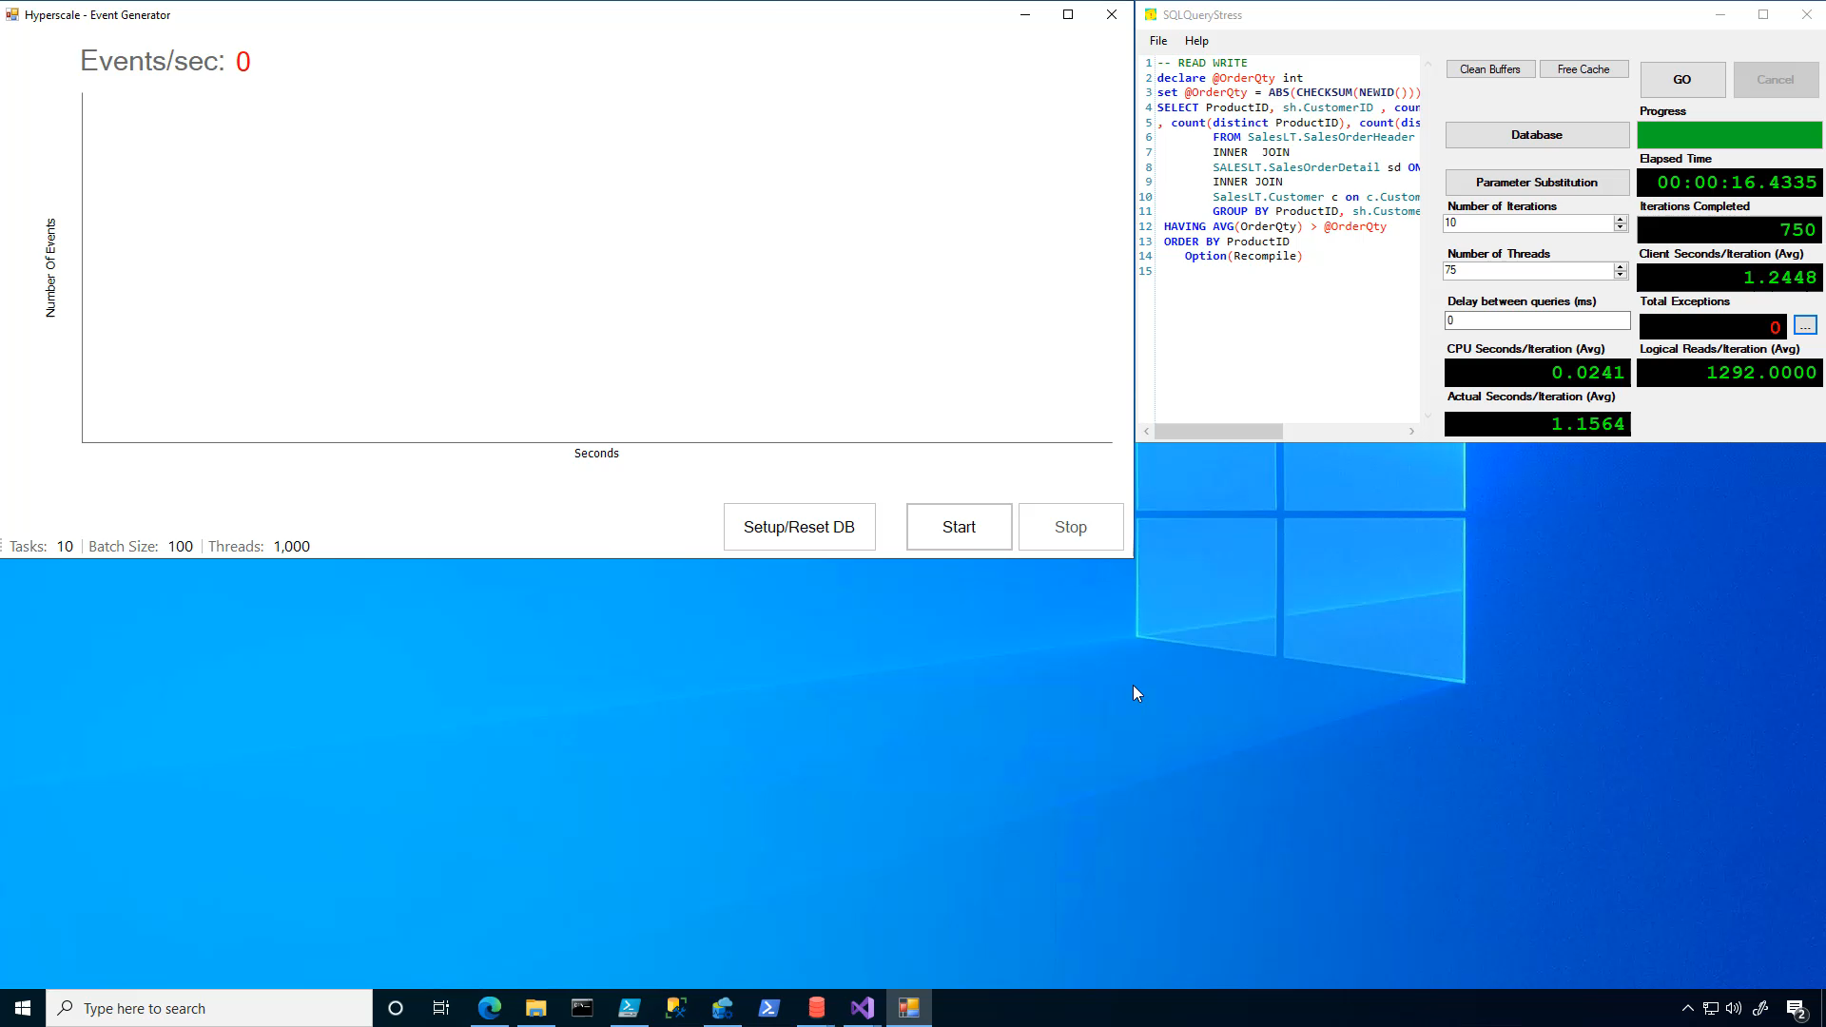

Slide 20
Demo Azure SQL Database Hyperscale
Notes:
LAYOUT : 2 Person Demo -> Presenter 1 Desktop
Anna

Slide 21
Azure SQL Database Serverless
CPU usage
Line of business apps
Expense reporting and employee tracking apps
Procurement systems
4
E-commerce
Opening new marketplaces, marketing campaigns, sales promotions
Inactive
Paused
Number vCores
1
Dev/test workloads
Handling unpredictable workload needs
0
1:00
4:00
5:00
8:00
8:00
9:00
10:00
11:00
12:00
13:00
14:00
15:00
16:00
17:00
18:00
19:00
20:00
21:00
22:00
23:00
0:00
2:00
3:00
6:00
7:00
Min vcores
Max vcores
Vcores used
Vcores billed
Overview
SQL Server on Azure VMs
Azure SQL MI
Azure SQL Database
Comparison and summary
Notes:
Anna
Line-of-business applications, dev/test databases, content management and e-commerce systems are just some examples across a range of applications that often fit the usage pattern ideal for serverless.
Serverless is also well-suited for new applications with compute sizing uncertainty or workloads requiring frequent rescaling in order to reduce costs.
Serverless automatically scales compute for single databases based on workload demand and bills for compute used per second. In serverless, compute scaling within configurable limits is managed by the service to continuously right-size resources. Serverless also provides an option to automatically pause the database during inactive usage periods and automatically resume when activity returns. During periods of inactivity, you only pay for storage.

Slide 22
Demo Azure SQL Database Serverless
Notes:
LAYOUT : 2 Person Demo -> Presenter 1 Desktop
Anna

Slide 23
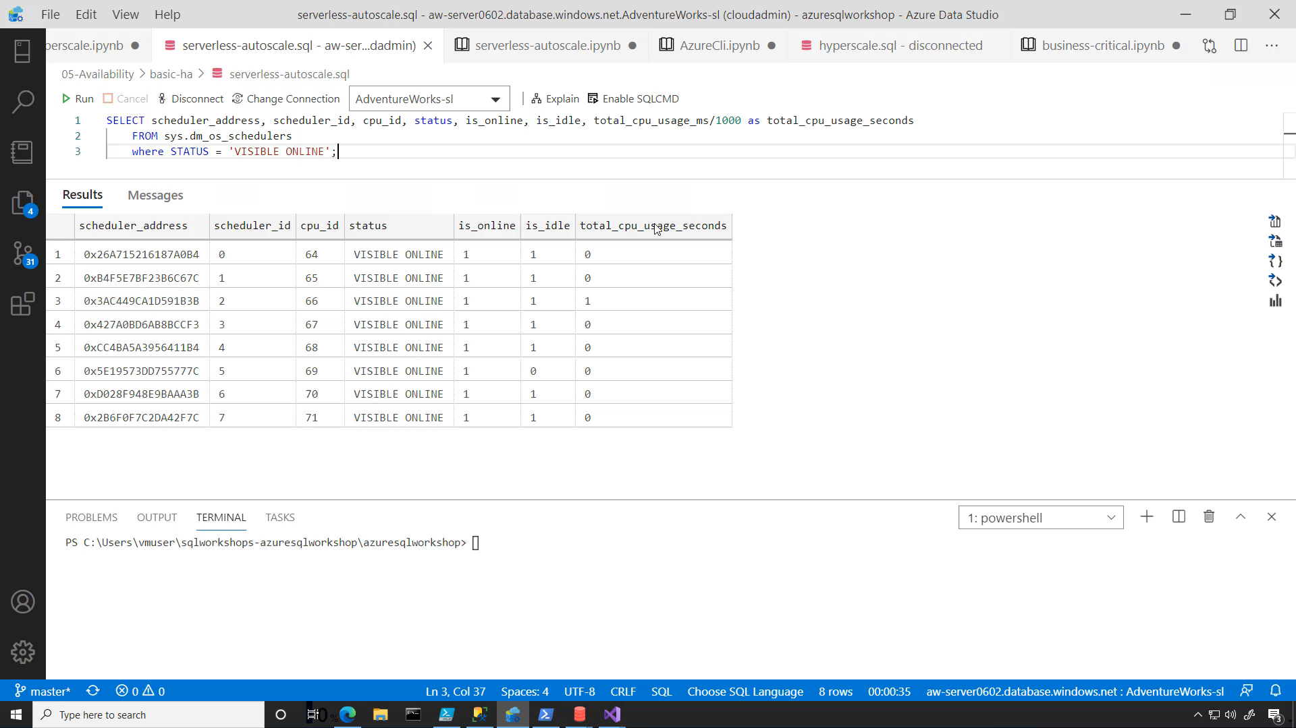

Slide 24
Demo Azure SQL Database Serverless
Notes:
LAYOUT : 2 Person Demo -> Presenter 1 Desktop
Anna

Slide 25
Knowledge check
Consider the following scenario:
You're moving an application and database to Azure, but your database is currently 62 TB, with plans to continue to grow. You don't currently leverage any instance-scoped features. Which Azure SQL deployment option will be the easiest to move to?
A. SQL Server in an Azure virtual machine
B. Azure SQL Managed Instance
C. Azure SQL Database - single database
D. Azure SQL Database - elastic pool
Consider the following scenario:
You have an Azure SQL Database with the Serverless compute tier database deployed, with an auto-pause delay of two hours. After two hours of no activity, what happens to your database and incurred charges?
A. Azure will pause your database to stop compute costs and only charge you for storage
B. The database resources are reduced to a lower service tier to reduce costs.
Notes:
NOTE – put both on same page
LAYOUT : 2 Person Demo. Next slide goes to 2 Person Desktop TR
Azure SQL Database - single database is currently the only deployment option that supports databases of that size, specifically with the Hyperscale service tier. If and when Azure SQL Managed Instance supports Hyperscale, since the application doesn't currently need any instance-scoped features, Azure SQL Database may still be the right option.
To reduce your costs during times of inactivity, Azure will pause the compute resources and will only charge for storage during this time.

Slide 26
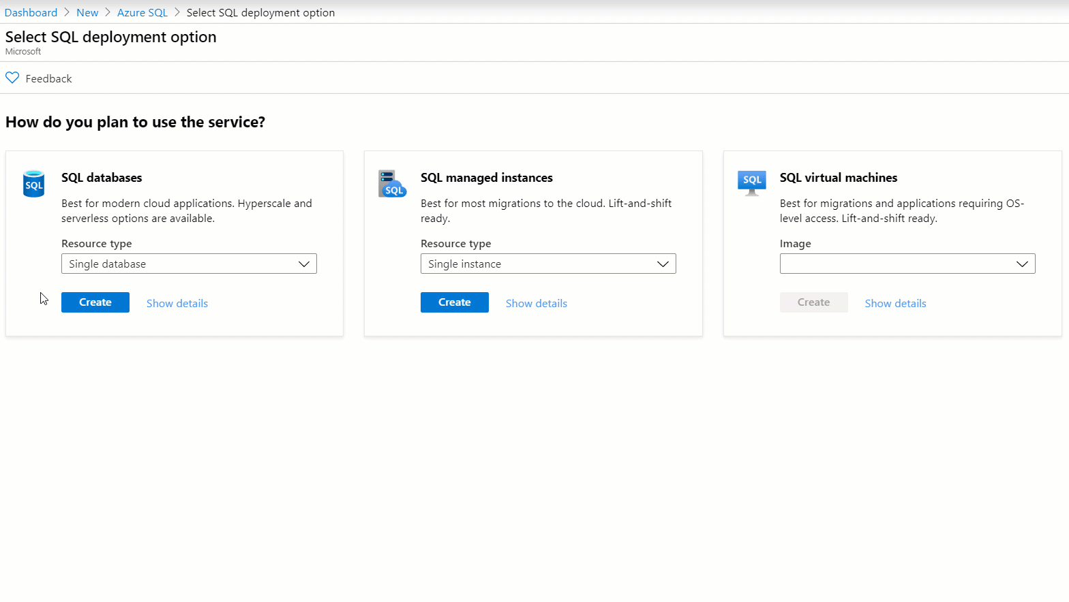
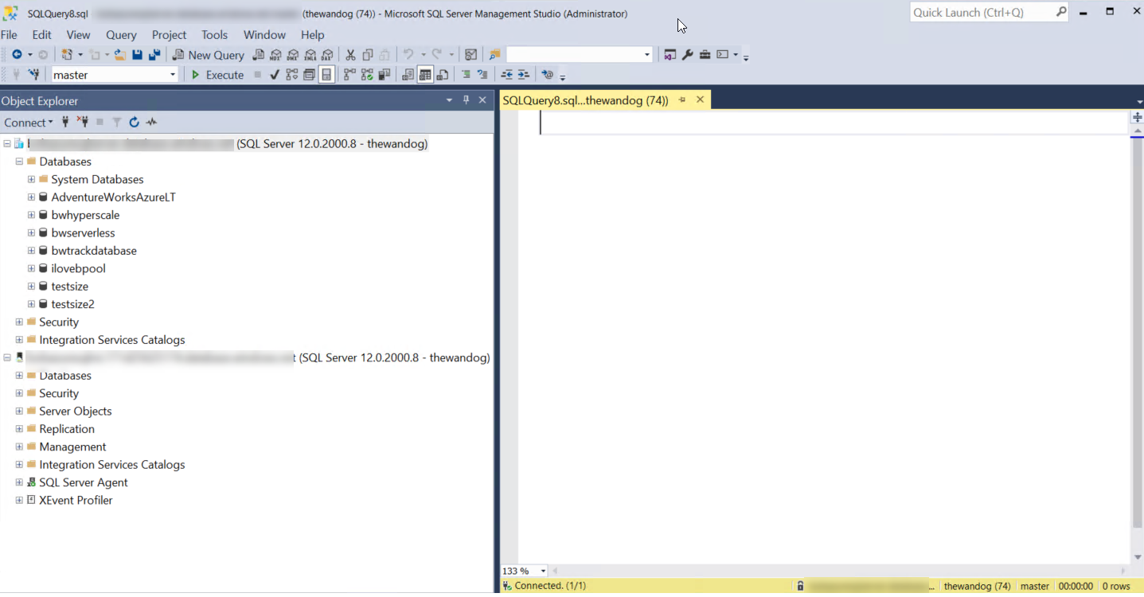
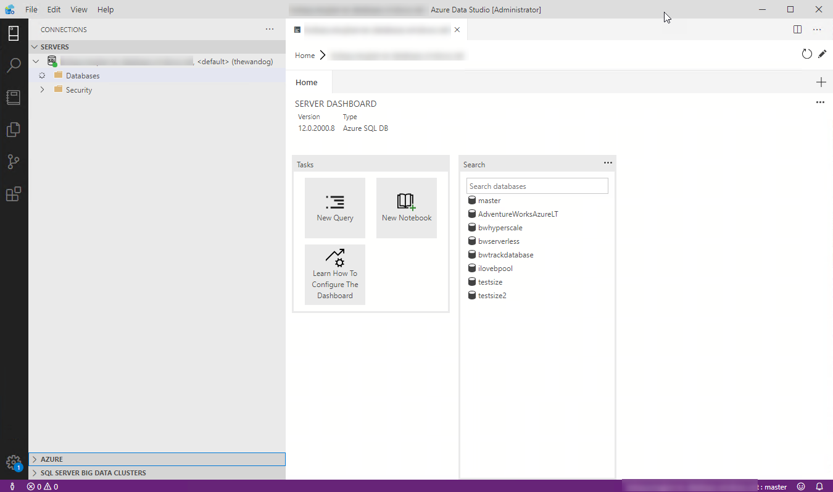


Interfaces for Azure SQL
T-SQL
Powershell
az cli
REST API
sqlcmd
bcp
Overview
SQL Server on Azure VMs
Azure SQL MI
Azure SQL Database
Comparison and summary
Notes:
Anna lead with Azure SQL unified experience in portal, Bob to follow with visual and CLI
LAYOUT : 2 Person Desktop TR. Next slide goes to 2 Person Demo

Slide 27
Demo Azure SQL unified experience
Notes:
LAYOUT : 2 Person Demo -> Presenter 1 Desktop
Anna

Slide 28
Summary
Azure SQL has evolved into the world’s database
Azure SQL includes Virtual machine, Managed Instance, and Database
SQL Server on Azure Virtual Machines is best for 100% lift and shift
Azure SQL Managed Instances: Database engine instance + power of PaaS
Azure SQL Database for modern cloud apps providing you the most PaaS capabilities
Overview
SQL Server on Azure VMs
Azure SQL MI
Azure SQL Database
Comparison and summary
Notes:
Bob summary, Anna what’s next.
LAYOUT : 2 Person Demo
Before we go what’s next, let’s take a look at the QUESTIONS

Slide 29
Resources
Try the Azure SQL Workshop
aka.ms/sqlworkshops
Microsoft Learn: Azure SQL Fundamentals
aka.ms/azuresqlfundamentals
Azure SQL documentation
aka.ms/azuresqldocs
More videos from our team
aka.ms/azuresql4beginners
aka.ms/dataexposed
This deck:
AKA.MS/ANNALYTICS
#AzureSQL @AzureSQL @AnalyticAnna
Overview
SQL Server on Azure VMs
Azure SQL MI
Azure SQL Database
Comparison and summary
Notes:
Anna

Slide 30
Thank you!
twitter: @AnalyticAnna @AzureSQL #AzureSQL
Notes:
Layout: 2 Person Demo -> 2 Person Chat
Bob and Anna

Slide 31
Azure Updates
App compatibility:
AAD logins, Trace Flags
Distributed Transactions (preview), ML services (preview),
SSRS catalog in MI
AAD Directory Readers role (preview)
Network and connectivity:
Public Endpoint, Service Endpoints, Subnet Delegation, Inbound and outbound subnet lockdown
Global VNet peering, TDE, TLS 1.2 enforcement, Data discovery and classification
PaaS features and manageability:
Failover Groups, TDE BYOK, Accelerated DB recovery, PITR (deleted DBs , cross subscriptions), AAD password hash/pass-through auth, SCOM MP
Testing application fault resiliency
Management operations progress indicator, Alert management, Query Log Analytics from the portal
Backups – compression, configurable retention, redundancy options (LRS/ZRS/GRS)
Long term retention (preview)
Perf:
tempdb, log write throughput and IOPS improvements
Managed Instance
Recent
New
Notes:
The following PITR backup retention periods are available for databases on managed instance:
For active databases, it is possible to set the retention from 1-35 days using Azure Portal and PowerShell.
For deleted databases, it is possible to set the retention from 0-35 days* using PowerShell only.

Slide 32
SQL MI Performance Update (Perf v2)
Improved log rate for SQL MI GP:
Per-instance limit: 3MB/s per vCore (unchanged)
Per-instance max of 120 MB/s (up from 22 MB/s)
Per-DB limit (new)
FILE SIZE Per-DB LIMIT
≤ 512 GB 22 MB/s
> 512 GB 30 MB/s
> 1 TB 50 MB/s
> 2 TB 65 MB/s
Improved log rate for SQL MI BC:
Per-instance limit: 4MB/s per vCore
Per-instance max of 96 MB/s (up from 48 MB/s)
Data ingestion (log rate)
Test Results (SQL MI GP):
TPC-C – up to 4x transaction throughput
TPC-H – up to 23% lower execution time​
Scans – up to 2x throughput ​
Data Ingestion – 2x-3x data ingestion rate
BC: 96 MB/s
GP: 65 MB/s

Slide 33
Azure Updates
Hyperscale
Change Tracking (GA)
Geo DR (Preview)
DB Copy (Preview)
Serverless
Maximum vCore limit: 40 vCores
Minimum auto-pause delay: 1 hour
Broader API support including PS & CLI
Recent
New

Slide 34
Azure Updates
Platform
Private Link
PAUSED_RESUMABLE_INDEX_ABORT
UTF-8 support
New memory and compute optimized SKUs
Backup storage redundancy options
Zone redundancy for GP tier
AAD Server Principals
Virtual Machines
SQL IaaS Agent Extension
Free DR replica for on-premises
Free HA or DR Azure SQL Server
Automated patching
SQL 2019 Linux images
SQL FCI using Azure Shared Disk
Configure Always On AG through portal
Recent
New
Notes:
Service principal support to create Azure AD users
Azure AD "Directory readers" group support for server identities

Slide 35
Extra demos? Hyperscale Serverless
Notes:
LAYOUT : 2 Person Demo -> Presenter 1 Desktop
Anna

Slide 36
Knowledge check
Consider the following scenario:
You want to migrate to the cloud, but you leverage a third-party application which requires access to the operating system (OS). Which Azure SQL deployment option will be the easiest to move to?
A. SQL Server in an Azure virtual machine
B. Azure SQL Managed Instance
C. Azure SQL Database - single database
D. Azure SQL Database - elastic pool
Consider the following scenario:
You want to migrate to the cloud and remove some of the management associated with SQL Server, but your application leverages CLR and Service Broker capabilities from SQL Server. Which Azure SQL deployment option will be the easiest to move to?
A. SQL Server in an Azure virtual machine
B. Azure SQL Managed Instance
C. Azure SQL Database - single database
D. Azure SQL Database - elastic pool
Notes:
NOTE – put both on same page
LAYOUT : 2 Person Demo. Next slide goes to 2 Person Desktop TR
Correct! Only SQL Server in an Azure virtual machine gives you access to the underlying OS. In the PaaS deployment options, this is abstracted away from you, meaning Azure manages it, but you can't access it.
Azure SQL Managed Instance is the only PaaS service that supports instance-scoped features like CLR and Service Broker. A is also technically correct, but doesn't unlock the benefits that PaaS can offer.

Slide 37

General Purpose High Availability
Behaves like Failover Cluster Instance
Remote storage provides data redundancy within a datacenter
Backup files are in a different location with geo-redundancy
Failover decisions based on SQL and Service Fabric
Recovery time depends on spare capacity
Connectivity redirection built-in
Azure Region
Application
GW
GW
GW
Control Ring
Primary Replica
Failover
Nodes with spare capacity
SSD, tempdb
SSD, tempdb
Data and log files
Azure premium storage (LRS) data/log
Backup files
Azure standard storage
(RA-GRS)
Overview
Backup and restore
Built-in HA/DR
Availability and consistency
Configuring and monitoring availability
Summary
Notes:
Layout: 2 Person Desktop TR
Anna
Images from docs https://docs.microsoft.com/en-us/azure/sql-database/sql-database-high-availability
Notes:
Behaves like a Failover Cluster Instance
Azure Storage handles redundancy of files (LRS)
SQL coordinates with Service Fabric for failovers
Backups on different storage with GRS
SSD Cache is Azure Blob Cache
Tempdb kept on local storage
Applies to Azure SQL Database and MI
Force failover using Powershell (see more at https://docs.microsoft.com/en-us/powershell/module/az.sql/invoke-azsqldatabasefailover?view=azps-3.8.0) or REST. There are limits on how often you can do this.
Failover Logic
Spin up a new SQL Server instance on a node with availability
Attach SQL Database files
Run Recovery
Gateways updated for new node. No virtual network or listener required

Slide 38
Business Critical High Availability
Based on Always On Availability Groups
3 secondary replicas automatically created
Four replicas kept available
Backup files in a different location with geo-redundancy
At least one secondary must sync for commits
Automatic failover based on SQL and Service Fabric
Recovery time extremely fast
Connectivity redirection built-in
Read Scale-Out from one of the replicas
Azure Region
GW
GW
GW
Application
Control Ring
Secondary Replica
Secondary Replica
SSD, data, log
SSD, data, log
Primary Replica
AlwaysON Availability Group
SSD, data, log
Failover
Secondary Replica
SSD, data, log
Backup files
Azure standard storage
(RA-GRS)
Overview
Backup and restore
Built-in HA/DR
Availability and consistency
Configuring and monitoring availability
Summary
Notes:
Layout: 2 Person Desktop TR
Bob
Image comes from https://docs.microsoft.com/en-us/azure/sql-database/sql-database-high-availability#premium-and-business-critical-service-tier-availability
Four replicas kept available
This is a major benefit to users of Azure. For SQL Server, if a failover occurs, you are responsible to getting the old primary back as a new secondary if the machine is down. In Azure, we just provision a new replica and make it a new secondary.
This is a big difference from default configuration of AGs with SQL Server
At least one secondary must sync for commits
he primary node constantly pushes changes to the secondary nodes in order and ensures that the data is synchronized to at least one secondary replica before committing each transaction. This process guarantees that if the primary node crashes for any reason, there is always a fully synchronized node to fail over to.
Read more about read scale out at https://docs.microsoft.com/en-us/azure/sql-database/sql-database-read-scale-out
Force failover using Powershell (see more at https://docs.microsoft.com/en-us/powershell/module/az.sql/invoke-azsqldatabasefailover?view=azps-3.8.0) or REST. There are limits on how often you can do this.
Important note about read replicas
Read Scale-Out supports session-level consistency. It means, if the read-only session reconnects after a connection error caused by replica unavailability, it may be redirected to a replica that is not 100% up-to-date with the read-write replica. Likewise, if an application writes data using a read-write session and immediately reads it using a read-only session, it is possible that the latest updates are not immediately visible on the replica. The latency is caused by an asynchronous transaction log redo operation.

Slide 39

Hyperscale High Availability
Paired page servers
Redundant log and data through Azure Storage
Backup/Restore snapshots
Log Service feeds replicas
0 to 4 secondary replicas for read scale and failover
Automatic failover based on SQL and Service Fabric
Recovery time depends on existence of replicas
Read-Write
Read-Only
Compute nodes
Primary Compute
Secondary Compute
Secondary Compute
SqlServr.exe
SqlServr.exe
SqlServr.exe
Log Service
RBPEX Data Cache
RBPEX Data Cache
RBPEX Data Cache
Landing Zone
(Azure Premium Storage)
Page Servers
Log Service
Long term log storage for PITR (Azure Standard Storage)
Log Cache
Page Server
Page Server
…
Page Server
RBPEX Data Cache
RBPEX Data Cache
RBPEX Data Cache
Data File
Data File
Data File
Data Pathway
Log Pathway
Snapshots
Snapshots
Snapshots
Local SSD Cache
RBPEX
Resilient Buffer Pool Extension
Azure Standard Storage
Overview
Backup and restore
Built-in HA/DR
Availability and consistency
Configuring and monitoring availability
Summary
Notes:
Layout: 2 Person Desktop TR
Bob
Image from https://docs.microsoft.com/en-us/azure/sql-database/sql-database-service-tier-hyperscale#distributed-functions-architecture
Log Service feeds replicas. Transactions can commit when the log service hardens changes to the Landing Zone. The consumption of changes by a Secondary Compute replica is not required for commit
This technology does not use Always On Availability Groups but does you log records to feed changes to secondary replicas
Recovery time depends on existence of replicas
You are not required to have replicas for Hyperscale. If a replica does not exist, HA is still possible but it behaves more like General Purpose since a new primary replica must be deployed.
Backup/Restore snapshots
Hyperscale data files are on Azure Storage and since we have levels of “caching” we can use snapshots to quickly backup and restore a database even if the size is large.

Slide 40
Knowledge check
Which service tier puts the data and log files on Azure premium storage?
A. General purpose
B. Business Critical
C. Hyperscale
D. All of the above
Which service tier has an Always on Availability Group deployed behind the scenes?
A. General purpose
B. Business Critical
C. Hyperscale
D. All of the above
Notes:
LAYOUT : 2 Person Demo. Change to Desktop Only before moving to the next slide
NOTE – put both on same page
In General purpose, tempdb is on directly-attached SSD, but the data and log files are in Azure premium storage.
Business critical is similar to deploying an Always on Availability Group. You can even leverage one of the secondaries as a read-only endpoint.

Slide 41
Knowledge check
Consider the following scenario:
You're moving an application and database to Azure, but your database is currently 62 TB, with plans to continue to grow. You don't currently leverage any instance-scoped features. Which Azure SQL deployment option will be the easiest to move to?
A. SQL Server in an Azure virtual machine
B. Azure SQL Managed Instance
C. Azure SQL Database - single database
D. Azure SQL Database - elastic pool
Consider the following scenario:
You have an Azure SQL Database with the Serverless compute tier database deployed, with an auto-pause delay of two hours. After two hours of no activity, what happens to your database and incurred charges?
A. Azure will pause your database to stop compute costs and only charge you for storage
B. The database resources are reduced to a lower service tier to reduce costs.
Notes:
NOTE – put both on same page
LAYOUT : 2 Person Demo. Next slide goes to 2 Person Desktop TR
Azure SQL Database - single database is currently the only deployment option that supports databases of that size, specifically with the Hyperscale service tier. If and when Azure SQL Managed Instance supports Hyperscale, since the application doesn't currently need any instance-scoped features, Azure SQL Database may still be the right option.
To reduce your costs during times of inactivity, Azure will pause the compute resources and will only charge for storage during this time.

